Slide 1
Worked example in R

Slide 2
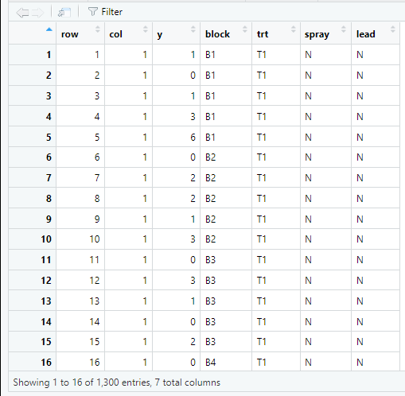
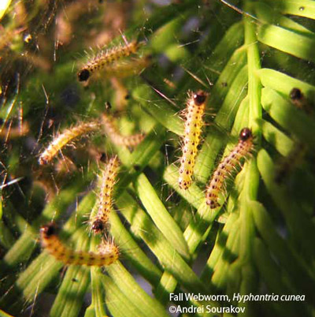
Beall webworm data
Counts of webworms in plots sprayed with insecticide or lead/arsenic
2 insecticide treatments (N/Y)
2 lead treatments (N/Y)
2 x 2 factorial design

Slide 3
Beall webworm data
Counts of webworms in plots sprayed with insecticide or lead/arsenic
2 insecticide treatments (N/Y)
2 lead treatments (N/Y)
2 x 2 factorial design

Slide 4
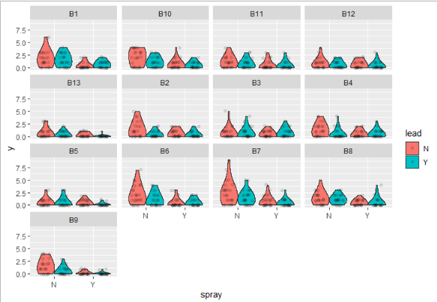
Beall webworm data
Counts of webworms in plots sprayed with insecticide or lead/arsenic
2 insecticide treatments (N/Y)
2 lead treatments (N/Y)
2 x 2 factorial design
Plots setup in blocks
Many subplots per block

Slide 5
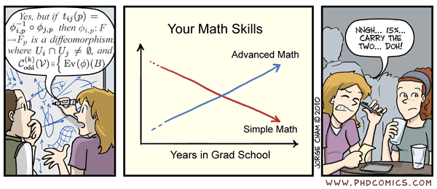
Steps for constructing and interpreting a GLMM
0. Data Exploration
Construct model
Fixed effects (predictor or explanatory variables)
Random effects (blocking variables)
Error distribution (response variable or dependent variable)
Assess residuals and overdispersion
Check random effects and/or distribution (not always needed)
Examine significance of terms in model
Anova
AIC model selection
Calculate treatment means and/or slopes
Construct contrasts
Calculate R2m and R2c
Make pretty figure

Slide 6
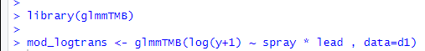
Step 1: Setting up a basic model in R
log⁡(y_{ij}+1)=β₀+β₁(lead_{i}*spray_{j})+ε_{ij}
* is shorthand for (spray + lead + spray:lead)

Slide 7
Step 2: Examine residuals (check assumptions)
Conventional residuals are not always useful for GL(M)Ms
How to diagnose your fitted GL(M)M using DHARMa?
The resulting residuals are standardized to values between 0 and 1
Can be interpreted as intuitively as residuals from a linear regression.
QQplot (points should line up against 1:1 line) – same as normal
Residual~predicted for homogeneity (residuals equal spread across predictor or among groups, no funneling, etc.) – same as normal
Histogram (should be flat, not normally distributed) – Different than normal
Plus additional tests of residual structure

Slide 8
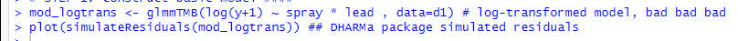
Step 2: Examine residuals

Slide 9
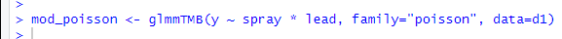

Step 1b. Setting up a GLM in R
log⁡(λ_{ij})=β₀+β₁(lead_{i}*spray_{j})
y_{ij} ~ Poisson(λ_{ij})

Slide 10
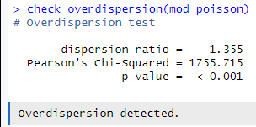
Step 2b. Check resids and overdisperion
>1 indicates overdispersion,
Usually >2 is problematic

Slide 11

What is overdispersion?
More variation in the data than expected based on the distribution
Poisson: λ = mean = variance
Most count data: variance > mean
Check: φ = Σ Pearson Resid^2/df
High values = more overdispersion
Alt: θ = overdispersion parameter
lower values are more overdispersion
higher values converge to Poisson
Need to correct!
Harrison 2014

Slide 12
Processes that generate overdispersion
Missing co-variates or random effects
Sampling (counting) errors
Non-independent (ie. aggregated) data
Environmental stochasticity
Many zeros (mixture of above, others, unknown)
Gelman and Hill 2007
Linden and Mantyniemi 2011 Ecology

Slide 13
What are consequences of overdispersion?
Confidence intervals too small
P-values too low, leading to Type I error
Biased parameter estimates

Slide 14
How to remedy overdisperion?

Slide 15
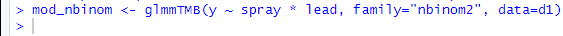

Step 1c. Update the GLM to correct overdisp.
log⁡(λ_{ij})=β₀+β₁(lead_{i}*spray_{j})
y_{ij} ~ Negative Binomial(μ_{ij}, φ _{ij})

Slide 16
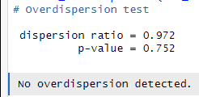
Step 2c. Check resids and overdisperion

Slide 17
Looks good! What did we miss?
Counts of webworms in plots sprayed with insecticide or lead/arsenic
2 insecticide treatments (N/Y)
2 lead treatments (N/Y)
2 x 2 factorial design
Plots setup in blocks
Many subplots per block
Fixed effects
Random effects
Error distribution

Slide 18
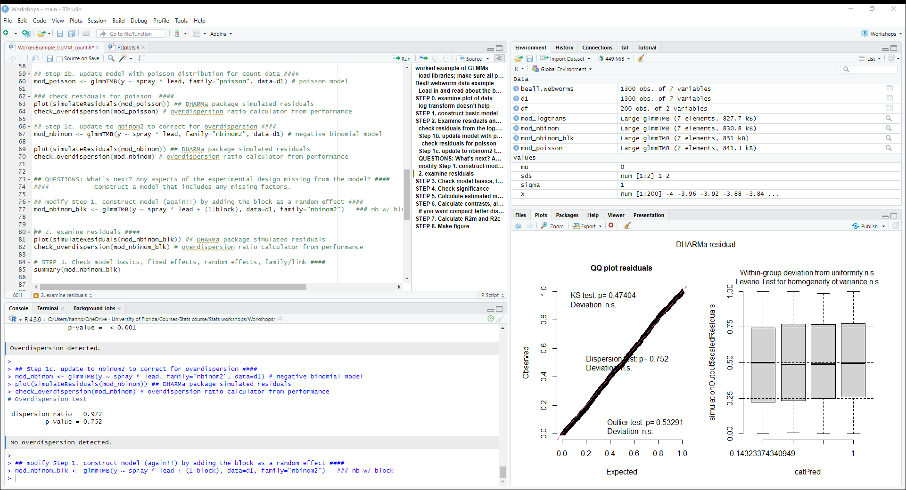
Step 1d. Update the GLM to correct overdisp.
log⁡(μ_{ijk}) = β₀ + β₁(lead_{i}*spray_{j}) + b_{k}
y_{ij} ~ Negative Bionomial(μ_{ij}, φ _{ij})

Slide 19

2d. Check residuals

Slide 20
The block is good… but is it the best?
AIC is a measure of model fit, balancing explanatory power and simplicity
Can use AIC to compare models with the same response variable
Models with different fixed and random effects
Can’t compare:
Transformed vs untransformed
Models with different families
Full dataset vs subsetted dataset (ie. outlier removed)
Lower AIC is better

Slide 21
The block is good… but is it the best?
model df AIC
mod_nbinom 5 3052.969
mod_nbinom_blk 6 3007.412
df is the number of parameters estimated by the model

Slide 22
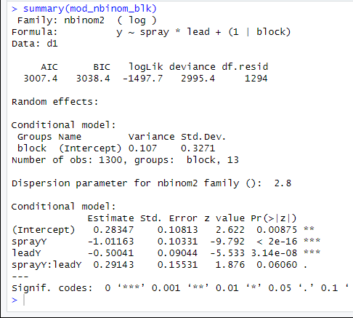
3. Check random effects and model basics
Model basics
AIC, etc. (not all that helpful)
Random effect “variance component”

Slide 23
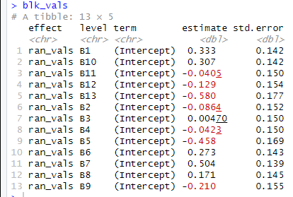
3. Check random effects and model basics
Model basics
AIC, etc. (not all that helpful)
Random effect “variance component”
σ²

Slide 24
3. Check random effects and model basics
Model basics
AIC, etc. (not all that helpful)
Random effect “variance component”
Dispersion parameter (θ)
Note: this in inverse of phi (φ):
φ = 1/ θ
Parameter estimates on log-scale
Not all that helpful in this format, but used to calculate group means
(see Step 5)

Slide 25
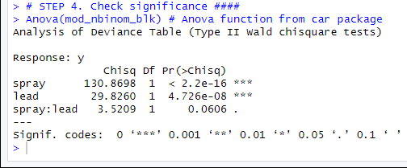
Step 4. Check significance
Wald X2 test can be interpreted just like a regular ANOVA table
Anova() function is from car package; other packages will give different results

Slide 26
Where do p-values come from?
F-value
Chi-sq value
From least squares
F = MS_{B} / MS_{W}
Calculate “p” from F-dist
From maximum likelihood
χ2 = (effect size / SE)²
Calculate P from X2-dist

Slide 27
A note about p-values
Muff et al. 2022 https://doi.org/10.1016/j.tree.2021.10.009
Murtaugh 2014 https://doi.org/10.1890/13-0590.1

Slide 28
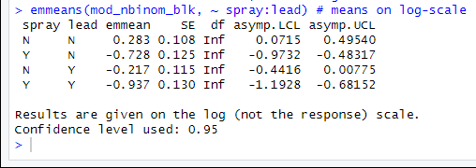
Step 5. Calculate treatment means

Slide 29
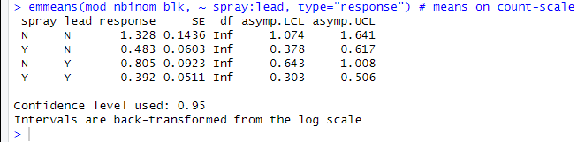

Step 5. Calculate treatment means (backtransformed)

Slide 30
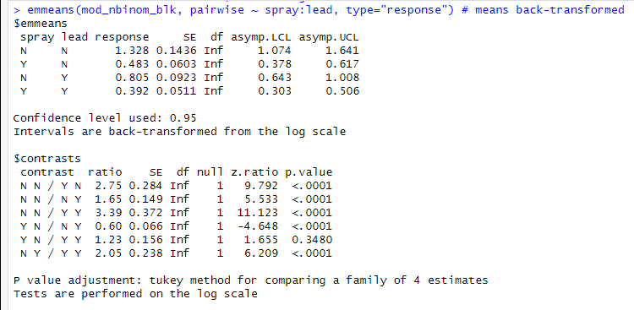

Step 6. Conduct contrasts
Note: in this case there are only 4 treatment combinations, so comparing them all is probably reasonable. In other cases, just make sure to think about your hypotheses and if it makes sense to compare them all, or if you only want to make a subset of comparisons.

Slide 31
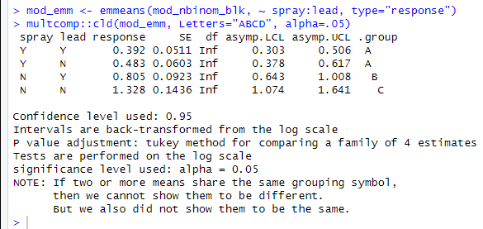
Step 6. Conduct contrasts - letters

Slide 32
Step 6. Conduct contrasts
Lots more you can do with contrasts
https://rvlenth.github.io/emmeans/articles/AQuickStart.html
Can also calculate slopes (when estimated) using emtrends from the emmeans package
https://rvlenth.github.io/emmeans/reference/emtrends.html

Slide 33
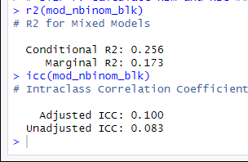
7. Calculate R2m and R2c
Marginal R2 (R²_{m}): Variance explained by fixed effects
Conditional R2 (R²_{c}): Variance explained by fixed + random effects
Intraclass correlation coefficient (ICC): Variance explained by random effects only
R2c ≈ R2m + ICC
Nakagawa, S., Johnson, P. C. D., and Schielzeth, H. (2017). The coefficient of determination R2 and intra-class correlation coefficient from generalized linear mixed-effects models revisited and expanded. Journal of The Royal Society Interface, 14(134), 20170213.

Slide 34
Step 8. Make graphs
Return to this in the afternoon

Slide 35
Steps for constructing and interpreting a GLMM
0. Data exploration
Construct model (glmmTMB works for everything)
Fixed effects
Random effects
Error distribution
Convergence okay?
Assess residuals and overdispersion
Residual diagnostics with DHARMa::simulateResiduals
Check overdisperion with check_overdispersion, correct using obs-level random effect or nbinom2
Check random effects and/or distribution using AIC or LRT (not always necessary)
Examine significance of terms in model (alt. AIC model selection for fixed effects)
car::Anova
Calculate emmeans and/or emtrends
Backtransform using type=“response”
Construct contrasts (also emmeans/emmtrends)
Calculate R2m and R2c
MuMin::r.squaredGLMM()
Which one??? Log-normal ok w/ log link; delta always ok.
Make pretty figure

